Slide 1
Smart Device Consumer Report
Presented by: Ahmed G.
Last Updated: May 30th, 2022

Slide 2
Table of Contents
- Purpose for analysis
- Analysis of data
- Findings
- Recommendations

Slide 3
Objective
- Identify how consumers use non-Bellabeat smart devices
- Observe trends based on consumer data
- How to apply insights to a Bellabeat product using new market strategy

Slide 4
Smart Device Consumers
Focus on consumers who use the following smart device features:
- Track daily activity
- Track daily step count

Slide 5
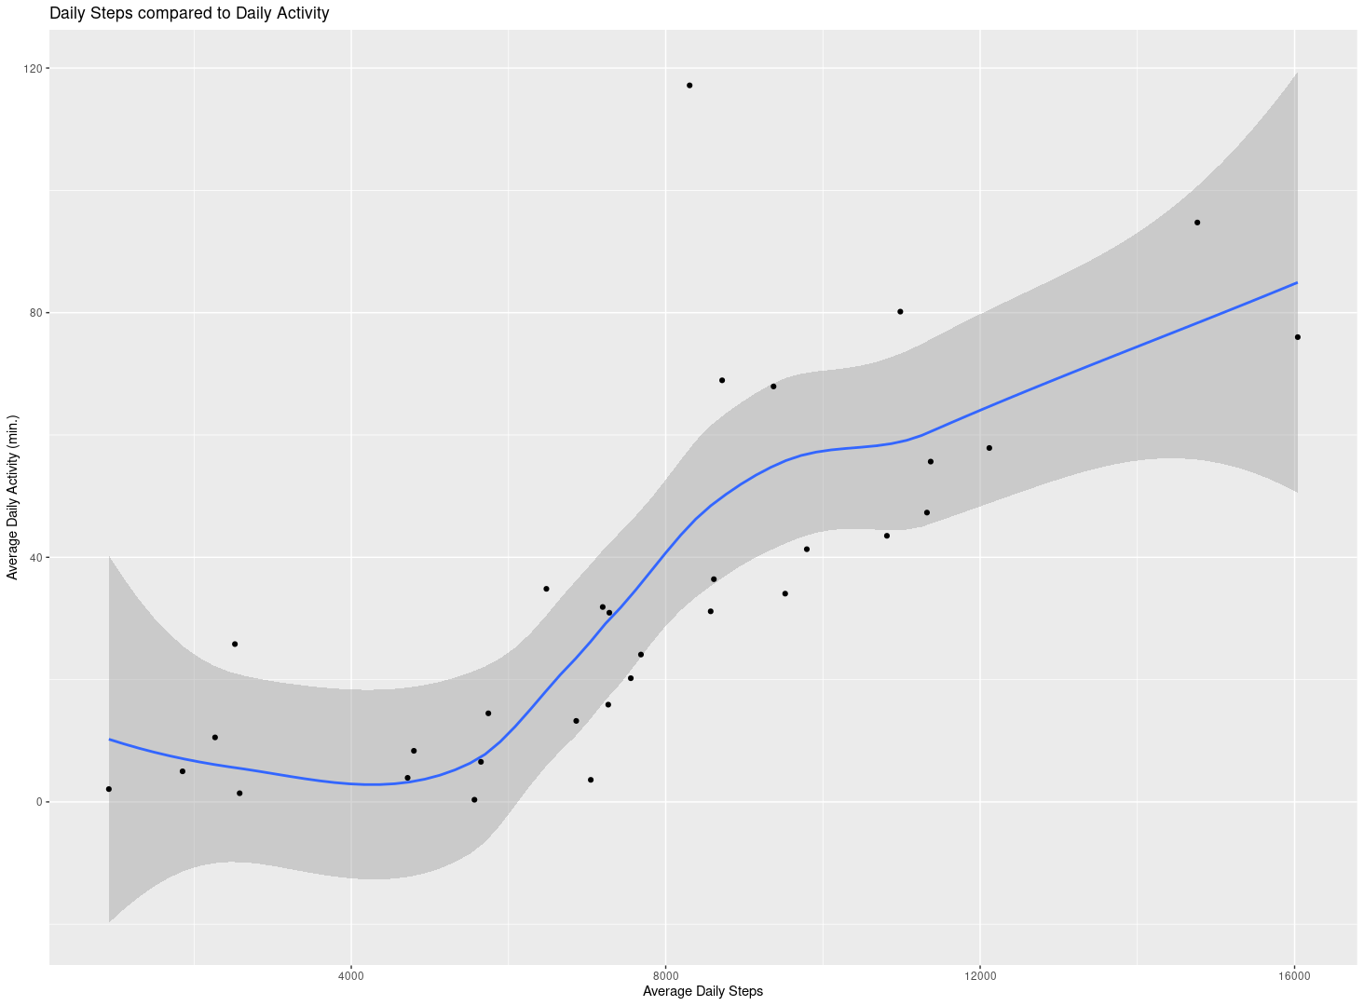
Activity Time vs. Step Count
- Correlation between step count and activity time
- As step count increases, activity time also increases
- Positive trend line

Slide 6
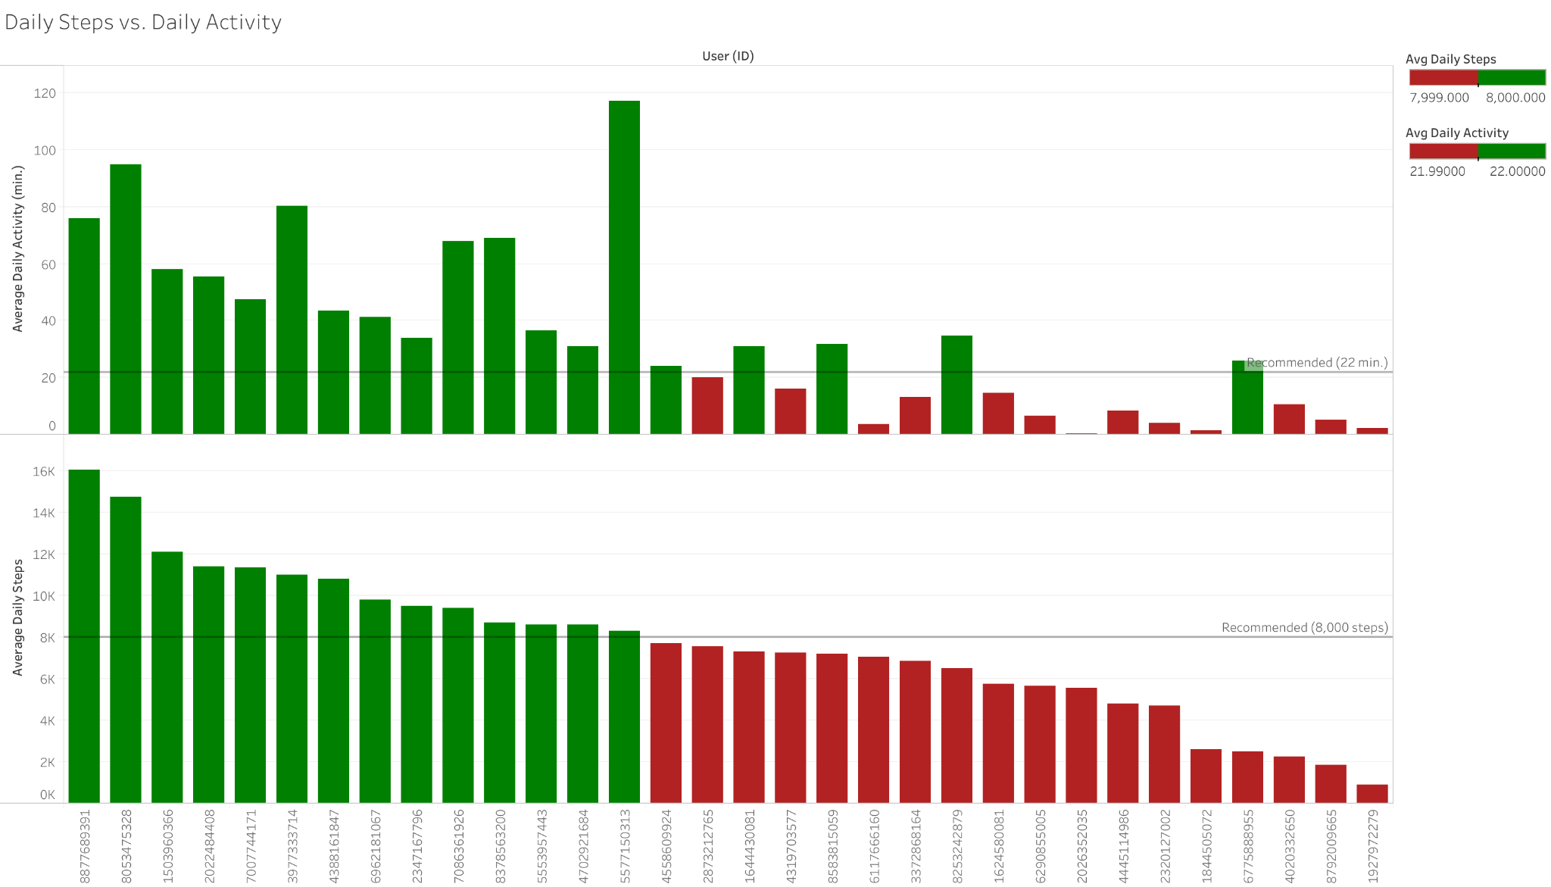
Recommended Activity and Steps
- Correlation between step count and activity time
- All users who met daily step count also met daily activity time

Slide 7
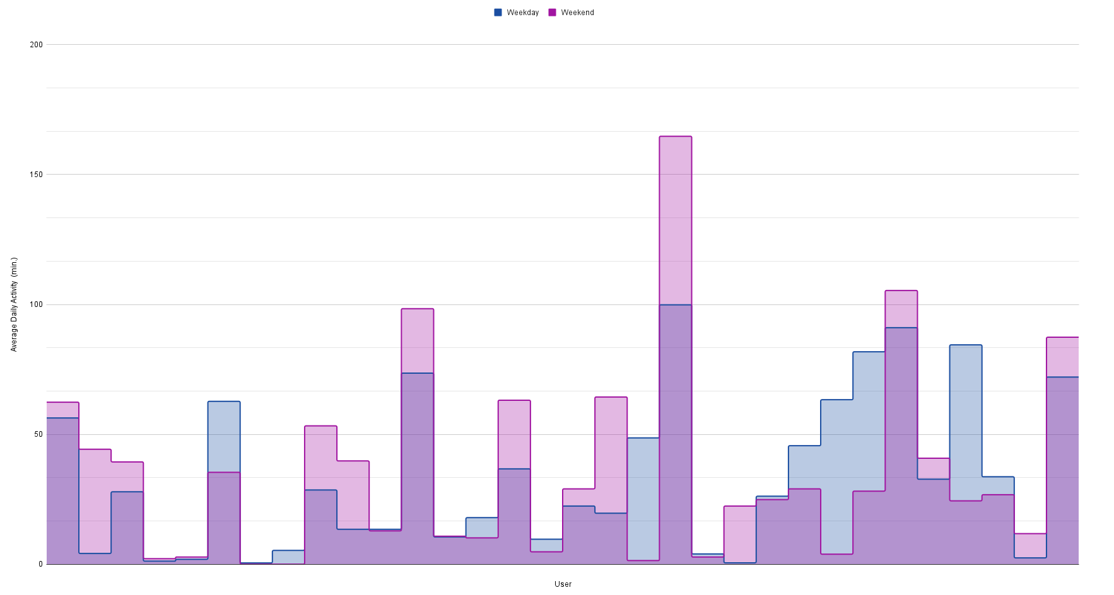
Weekday vs. Weekend Activity
- Typically, users have increased activity time on weekends over weekdays

Slide 8
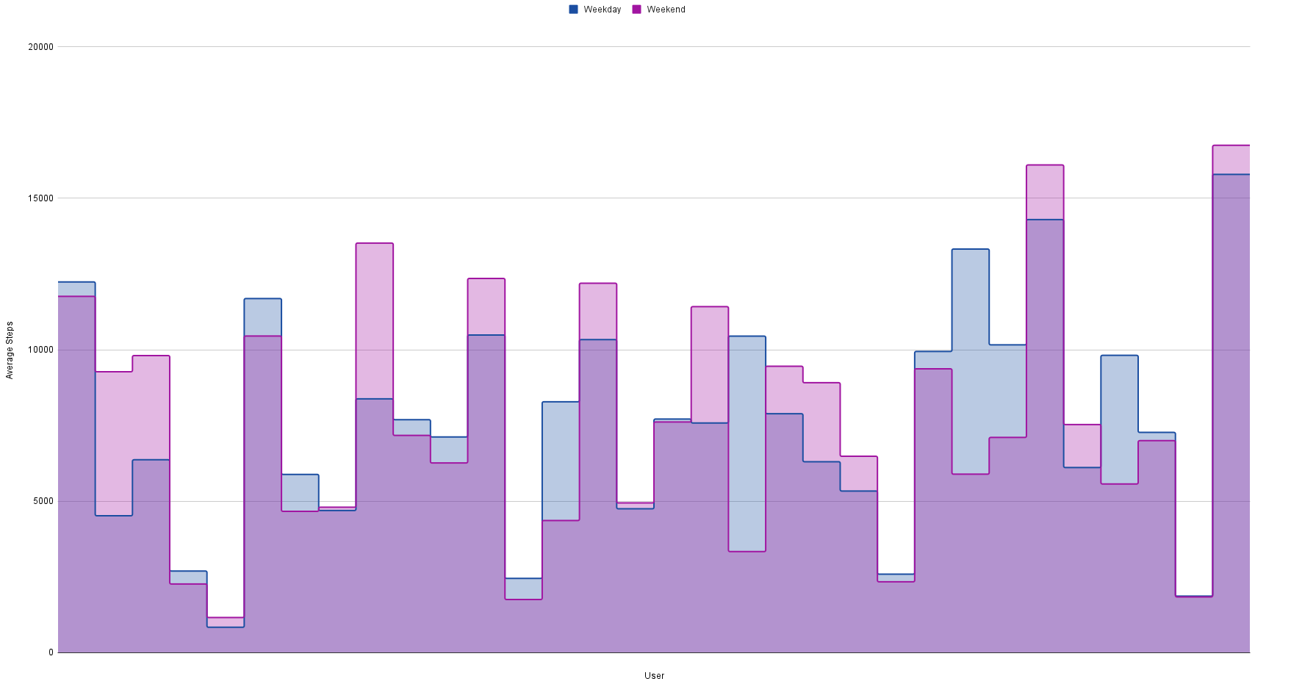
Weekday vs. Weekend Steps
- Typically, users have an increased step count on weekends over weekdays

Slide 9
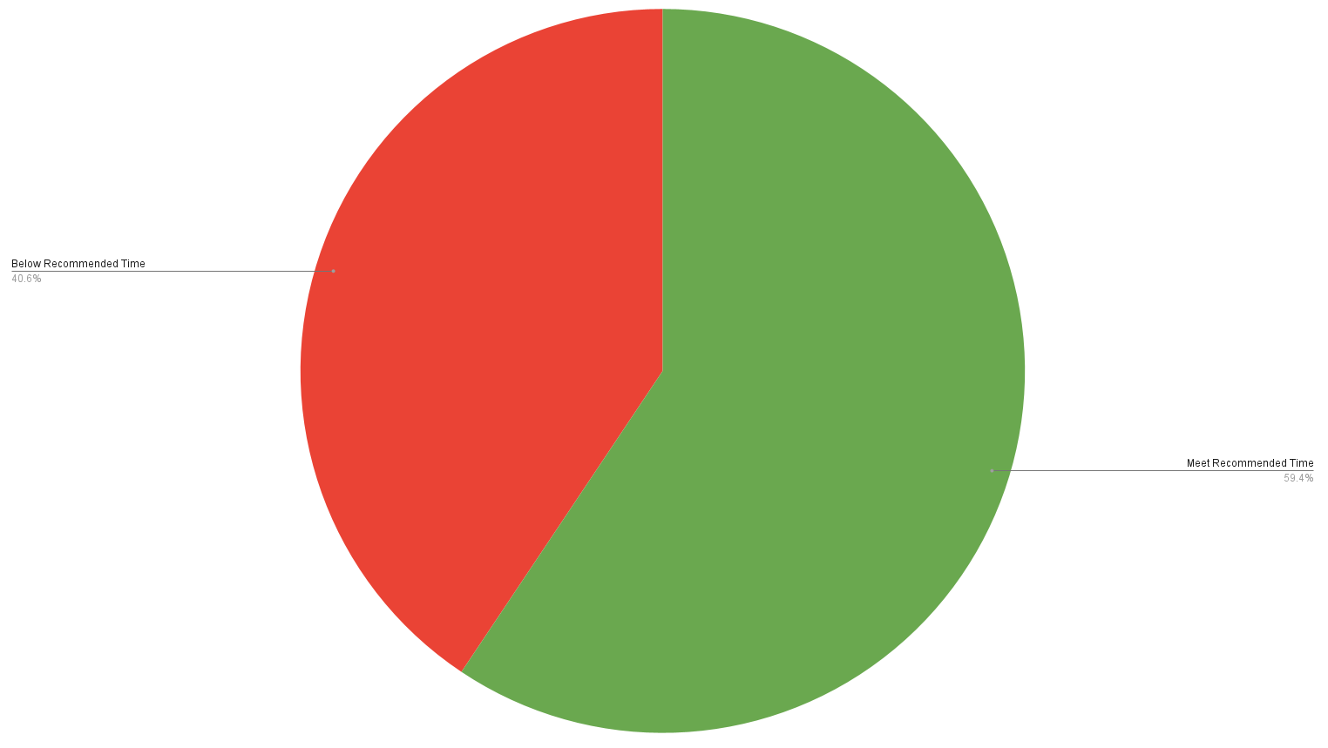
Recommended Activity Time
- About 40% of people in the survey data do not achieve recommended activity time of 22 minutes per day (150 minutes per week)

Slide 10
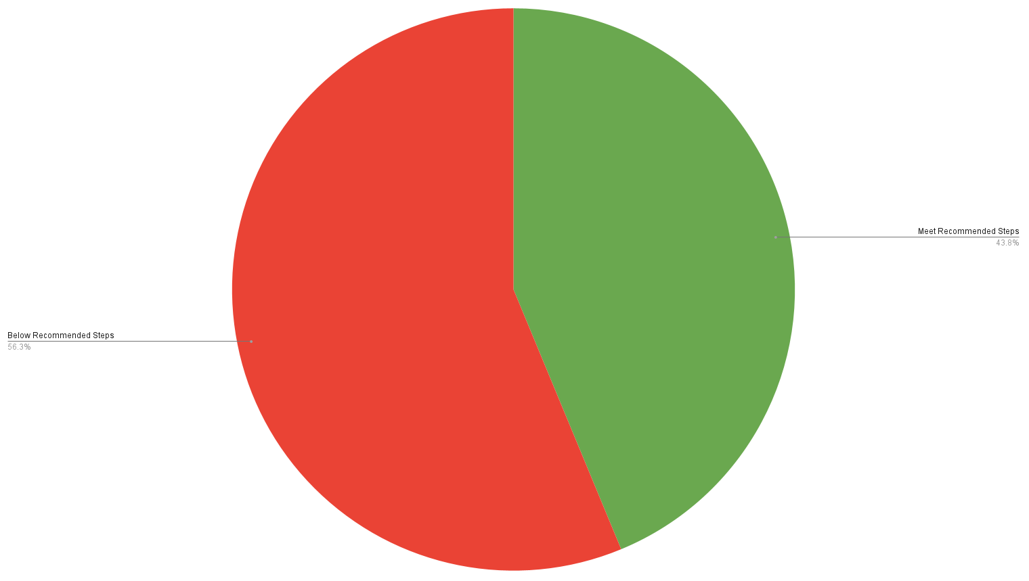
Recommended Step Count
- Over 55% of people in the survey data do not achieve recommended steps count of 8,000 steps per day

Slide 11
Recommendations
- Target smart watch product users to be consistent with survey data used
- Urge consumers to increase daily step count
- An increased step count is likely to increase activity time to meet recommended time
- Focus on increasing step count during weekdays specifically

Slide 12
Sources
- Survey Data Source: https://www.kaggle.com/datasets/arashnic/fitbit (data sourced from Amazon Mechanical Turk between 03.12.2016 - 05.12.2016)
- Recommended Activity Time: https://www.cdc.gov/physicalactivity/basics/adults/index.htm (Centers for Disease Control and Prevention)
- Recommended Step Count: https://www.cdc.gov/media/releases/2020/p0324-daily-step-count.html (Centers for Disease Control and Prevention)

